Slide 1

Remote Controlled Bluetooth Car
Review 3
EC I.D : 190171
Team Members :
1. G. Varaprasad (19BCE7048) Guided by -
2. K. Sai Srinivas (19BCI7017) S. Gopi Krishnan Sir
3. B. Sai Bipin (19BCD7025) ( Dept.of CSE )
4. K.J.Sreeja (19MIS7046)
5. N.Prudhvi (19BEC7129)

Slide 2
Agenda
Completed working prototype
Architecture/Design circuits
Objectives meeting outcome
Results with Screenshots
Future improvements can be made
References

Slide 3
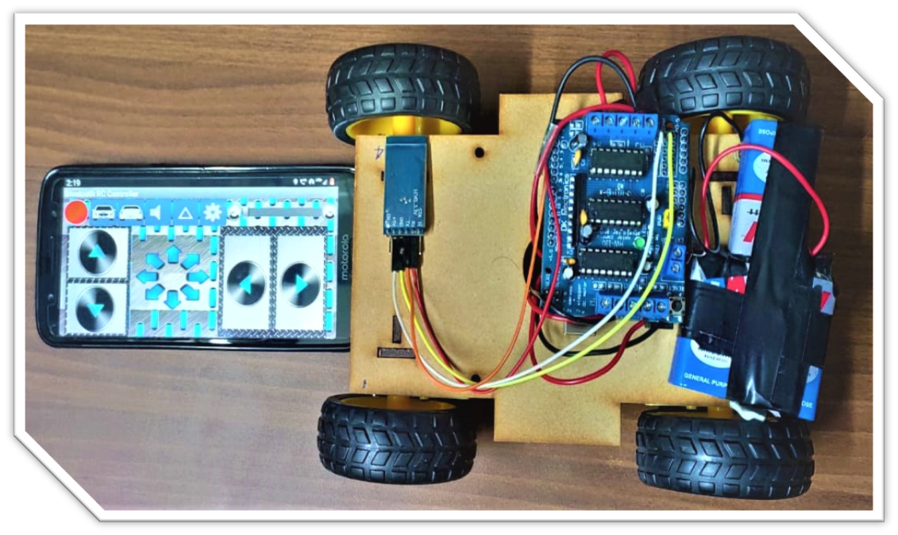
Completed working prototype
Mobile
CAR

Slide 4
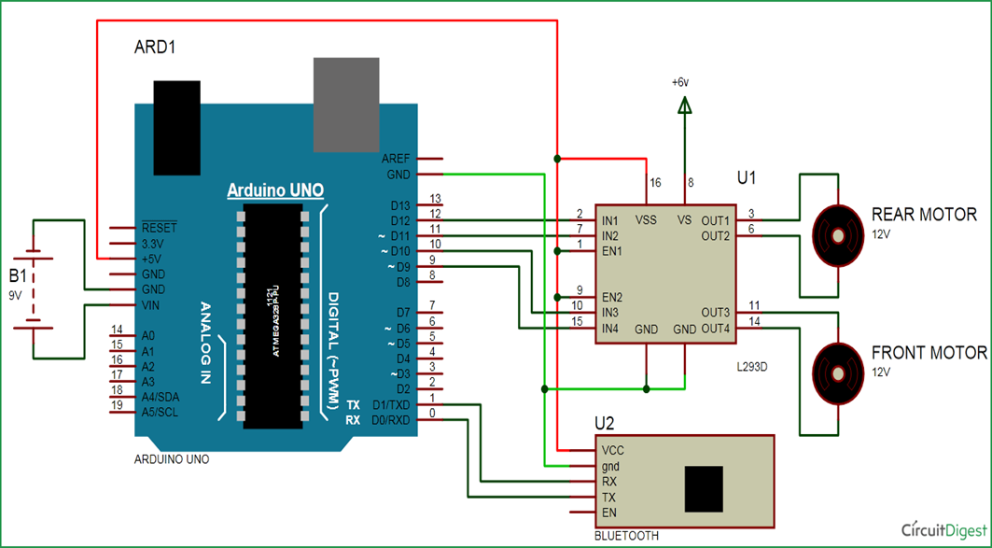
Architecture / Design circuits
Motor Driver IC
UNO

Slide 5
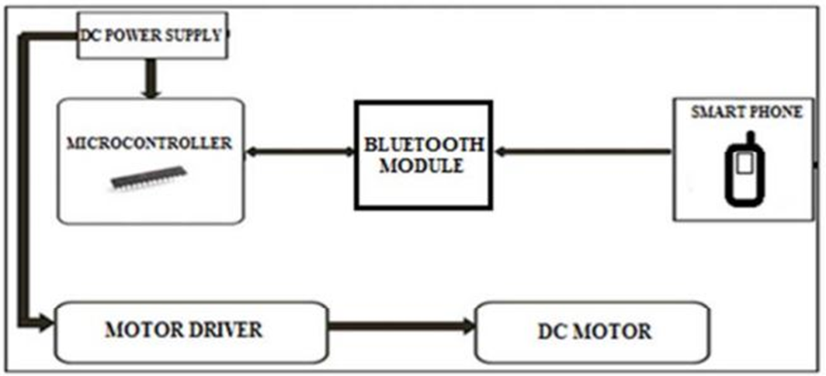
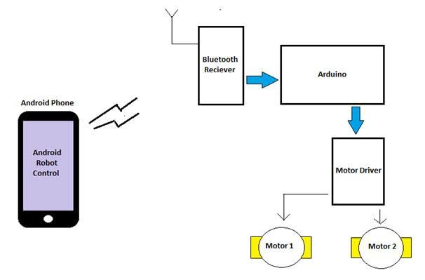
Block Diagrams
Working of the Project
Block diagram of the proposed System

Slide 6
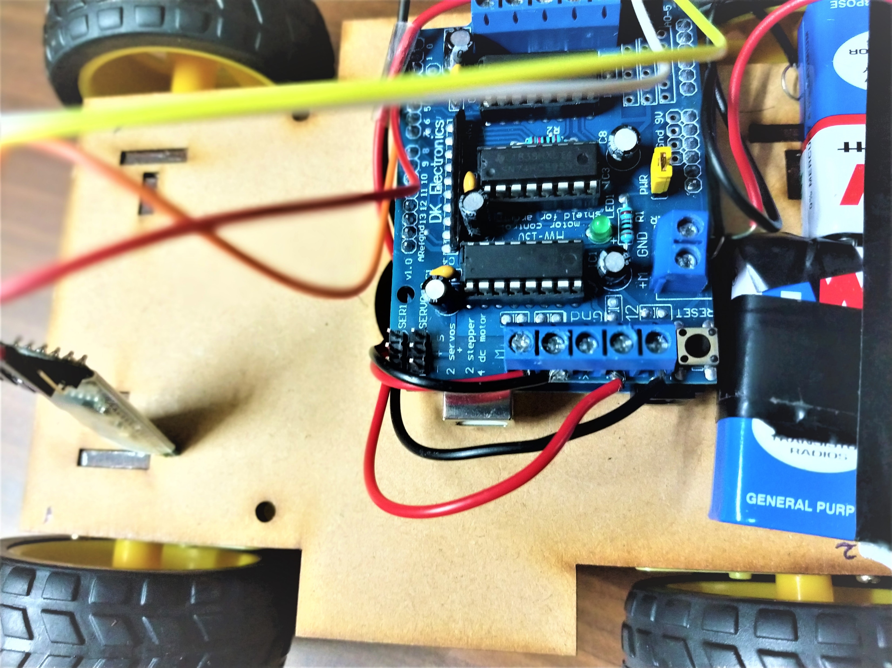
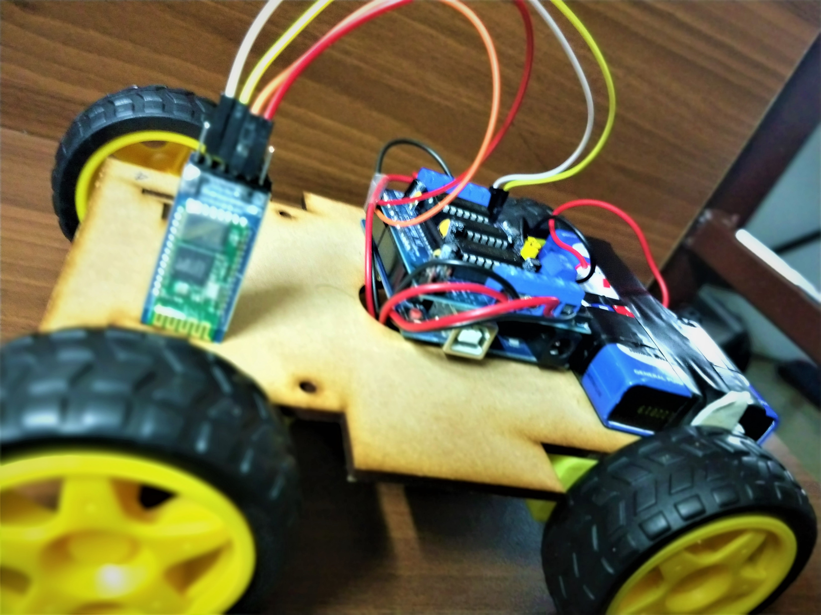
Images of Original Circuit

Slide 7
Objectives meeting outcome
The following objectives has been accomplished by our working prototype
As we mentioned before our objectives were as follows :
The objective of this project is to design and develop a wireless communication link and is based on Bluetooth controlled assist system, developed using electronic and mechanical arrangement.
They make Physically Challenged people to helm their robot around their space.
This is a Single equipment with Multiple Applications.
The Bluetooth Control System is relatively new concept that is being slowly tested on the latest Technology.

Slide 8
switch(command){
case 'F':
forward();
break;
case 'B':
back();
break;
case 'L':
left();
break;
case 'R':
right();
break;
}
}
}
void forward()
{
motor1.setSpeed(255); //Define maximum velocity
motor1.run(FORWARD); //rotate the motor clockwise
motor2.setSpeed(255); //Define maximum velocity
motor2.run(FORWARD); //rotate the motor clockwise
motor3.setSpeed(255);//Define maximum velocity
motor3.run(FORWARD); //rotate the motor clockwise
motor4.setSpeed(255);//Define maximum velocity
motor4.run(FORWARD); //rotate the motor clockwise
}
Coding :
#include <AFMotor.h>
//initial motors pin
AF_DCMotor motor1(1, HIGH);
AF_DCMotor motor2(2, HIGH);
AF_DCMotor motor3(3, HIGH);
AF_DCMotor motor4(4, HIGH);
char command;
void setup()
{
Serial.begin(9600);
}
void loop(){
if(Serial.available() > 0)
{
command = Serial.read();
Stop(); //initialize with motors stoped
//Change pin mode
//Serial.println(command);

Slide 9
void back()
{
motor1.setSpeed(255); //Define maximum velocity
motor1.run(BACKWARD); //rotate the motor anti-clockwise
motor2.setSpeed(255); //Define maximum velocity
motor2.run(BACKWARD); //rotate the motor anti-clockwise
motor3.setSpeed(255); //Define maximum velocity
motor3.run(BACKWARD); //rotate the motor anti-clockwise
motor4.setSpeed(255); //Define maximum velocity
motor4.run(BACKWARD); //rotate the motor anti-clockwise
}
void left()
{
motor1.setSpeed(255); //Define maximum velocity
motor1.run(BACKWARD); //rotate the motor anti-clockwise
motor2.setSpeed(255); //Define maximum velocity
motor2.run(BACKWARD); //rotate the motor anti-clockwise
motor3.setSpeed(255); //Define maximum velocity
motor3.run(FORWARD); //rotate the motor clockwise
motor4.setSpeed(255); //Define maximum velocity
motor4.run(FORWARD); //rotate the motor clockwise
}
void right()
{
motor1.setSpeed(255); //Define maximum velocity
motor1.run(FORWARD); //rotate the motor clockwise
motor2.setSpeed(255); //Define maximum velocity
motor2.run(FORWARD); //rotate the motor clockwise
motor3.setSpeed(255); //Define maximum velocity
motor3.run(BACKWARD); //rotate the motor anti-clockwise
motor4.setSpeed(255); //Define maximum velocity
motor4.run(BACKWARD); //rotate the motor anti-clockwise
}
void Stop()
{
motor1.setSpeed(0); //Define minimum velocity
motor1.run(RELEASE); //stop the motor when release the button
motor2.setSpeed(0); //Define minimum velocity
motor2.run(RELEASE); //rotate the motor clockwise
motor3.setSpeed(0); //Define minimum velocity
motor3.run(RELEASE); //stop the motor when release the button
motor4.setSpeed(0); //Define minimum velocity
motor4.run(RELEASE); //stop the motor when release the button
}

Slide 10

Video Demo
This is indeed a cost-effective and efficient project. The novelty lies in the fact that it is a cost-effective project with a simple and easy to use interface compared to existing ones.
Also the Bluetooth RC Controller application is more user friendly. The robot is small in size so it can be used in spying purpose. With few additions and modifications, this robot can be used in army for detecting and disposing hidden land mines.
The robot can be used for surveillance. In future we can interface sensors to this robot so that it can monitor some parameters and we can improve the efficiency using Internet of Things (IoT) technology.
We can also add wireless camera, in order to incorporate other security features. We are now living in the 21st century. Now, smart phone has become the most essential thing in our daily life.
Android application based smart phones are becoming each time more powerful and equipped with several accessories that are useful for Robots.

Slide 11
Future Improvements
For now the working prototype can be controlled by Smart Phone and it moves according to the input of the user.
Now it works on Bluetooth controlled assist system, developed using electronic and mechanical arrangement.
The accuracy of the model can be improvised from a small region to a big region like :
The same concept can be used in Home Automation, We can interface sensors to this robot so that it can monitor some parameters. We can add wireless camera to this robot. In the Military Domain to safeguard and help soldiers, and These robots are used in industries to control trolly and lift the things.
They make Physically Challenged people to helm their robot around their space.
The robot can be used for reconnaissance or surveillance.

Slide 12

References
1. Information Reference (
https://www.slideshare.net/SimarjotSinghKalsi/bluetooth-controlled-robot-project-report )
2. Idea of the Project (
)
https://www.youtube.com/watch?v=Ap-SZHJF8wU
3. About Arduino (
https://www.arduino.cc/en/Guide/HomePage
)
4. Knowledge of Electronics (
)
https://www.elprocus.com/major-electronic-components/
5. Purchase of Items (
)
https://www.amazon.com/electrical/b?node=495266

Slide 13
Thank You

